Slide 1
Chemistry Research Data Interest Group
WG/IG chairs Meeting, NIST, 11 Jan 2018
David Martinsen
Disclaimer: These views are mine, and not necessarily those of my Co-Chairs: Ian Bruno, Stuart Chalk, Richard Kidd, Leah McEwen
Chemistry Research Data Interest Group (bit.ly/digchem)

Slide 2
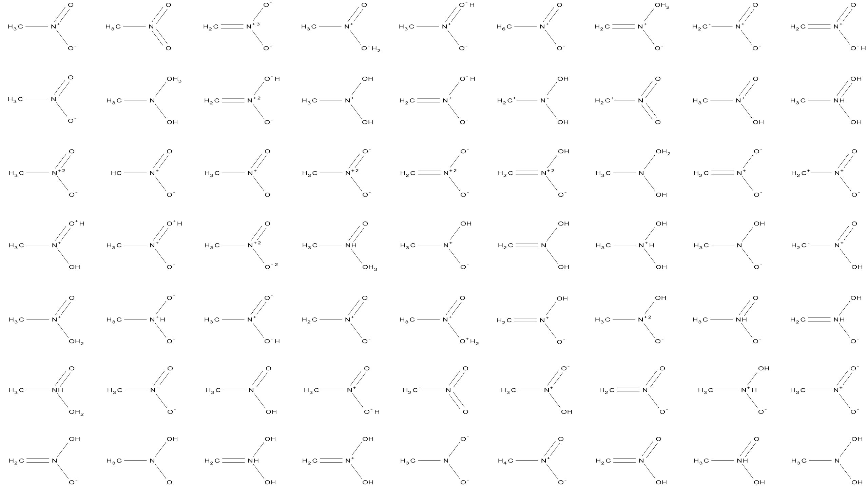
Digital Chemistry…
Brief recap of purpose of the IG and planned outcomes/aims
“a consistent global framework for Human AND Machine-readable
(and “understandable”) chemical information in collaboration with
other science communities, industry, and governments”
How best to disseminate and deploy
chemical data standards
and related assets
to support this digital framework?

Slide 3
Vision for chemical data standards
Cheminformatics Standards
Formats
Tools
Semantics
Curation
Instruments
Reviewer
Data
Experiments
Repositories
Human Reader
Devices
Machine Reader
Metadata
Internet of Things
Visualization

Slide 4



Chemical Data Publication Workflow
Chemical Sample
Spectrometer
Raw Data
Analysis Software
Processed Data
Supplemental
Information
Community
Discussion
Community
Discussion
Publisher
Figshare
Spectra
Data
Package
Spectra Files
FIDs
JCAMP-DX
Structure Files
CTABs
Identifiers
DOI
InChIs
PIDs
SI
Expt.
Images
Peer Review
Data Analyst
Standard
Standard
Standard
Human
Readers
Chemistry Research Data Interest Group (bit.ly/digchem)

Slide 5



















Standard Identifiers and Interoperability
    DOIs for Digital Objects
    Other persistent identifiers are available (ARKs, Handles, etc.)
    ORCID iDs for Researchers
    30% of current CSD depositors provide an ORCID iD
    IDs for Institutions
    See activities of the Organization Identifier Working Group
    InChIs for Chemical Structures
Identifiers for antibodies, organisms, cell lines, tools
https://www.force11.org/group/resource-identification-initiative
Identifiers for earths science samples and specimens
http://www.igsn.org/
Ack: I. Bruno
Chemistry Research Data Interest Group (bit.ly/digchem)

Slide 6
What has been accomplished to date?
*Prehistoric Times
1965: The Cambridge Structure Database
1971: Protein Databank
1974: Wiley Registry of Mass Spectral Data
1978: EPA/NIH Mass Spectra Database
1980s: IR
1980s: NMR
Communication from Steve Heller: In 1980 there were about 500 computer readable databases available in all fields of science, technology, business, and other areas, with some 75 companies making these databases available online in a computer system which was available for access by telephone and computer terminal connection.

Slide 7
What has been accomplished to date?
*Prehistoric Times
JCAMP-DX – spectra data file format (SCDS, several extensions)
InChI – chemical identifier (InChI Trust, several extensions)
  RInChI – reaction identifier
ThermoML – thermo-property data markup (NIST, current project revision)
Gold Book – compendium of IUPAC terminology (SCDS, current project revision)
In principle: 2013 Blue Book, Nomenclature for Organic Compounds
  Hierarchical criteria for preferred IUPAC name (PIN) allows for more systematic encoding of rule-sets in computer algorithms
Notes:
quadrant visual

Slide 8
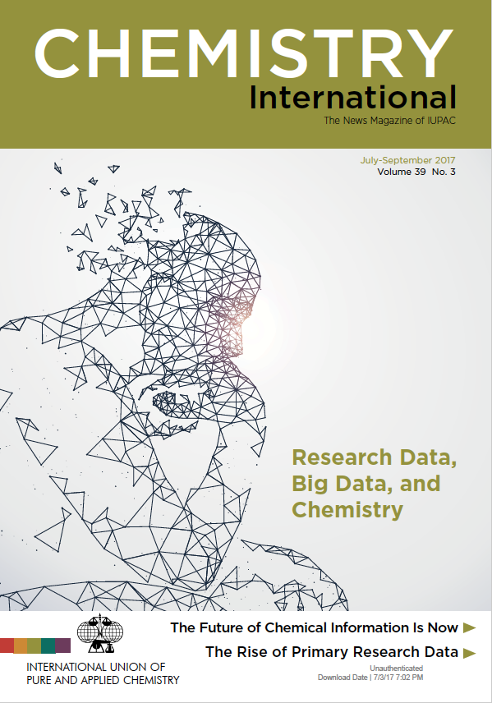
What has been accomplished to date?
Symposia and Open Meetings at ACS National Meetings, 2016, 2017
Symposium and Open Meeting at IUPAC General Assembly and Conference, 2017
IUPAC/RDA-US Workshop, 2016
CODATA Symposium and Workshop, 2017
EMBL-EBI Industry Programme Workshop, 2017
Beilstein Symposium – Open Science and the Chemistry Lab of the Future, 2017
DC VoCamp, 2016 & 2017
RDA Plenaries, 2015, 2016, 2017

Slide 9
What issues, challenges, problems, have been encountered?
Finding the right people
Chemists with domain knowledge don’t ordinarily attend RDA
Ontology experts, repository experts, metadata experts don’t ordinarily frequent chemistry meetings (unless they are reformed chemists)
Many groups are finding their own solutions (e.g., Allotrope Foundation, Pistoia Alliance, software vendors, instrument vendors)
Getting relevant use cases from non-chemists that really allow us to understand inter-disciplinary needs that the chemistry community should be focussing on.

Slide 10
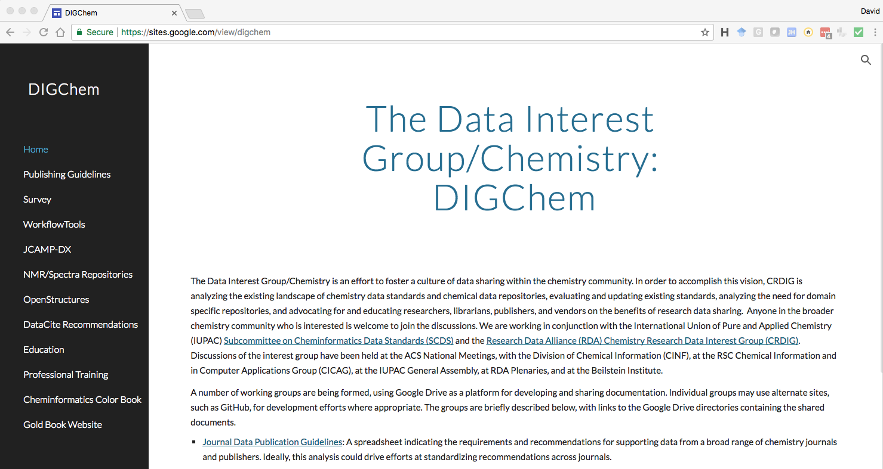
What is the plan for completion/progress for the coming 6-12 months?
Creation of DIGChem website, ready for launch: https://sites.google.com/view/digchem

Slide 11
What is the plan for completion/progress for the coming 6-12 months?
Symposia and Open Meetings at ACS National Meetings
Presence at RDA/Berlin
Cheminformatics Workshop in Amsterdam, July 16-17, 2018, cosponsored with CODATA, focus on GO FAIR, interoperability across disciplines, standards for spectral data
SciDataCon/Botswana, planning underway for an Inter-Union Workshop, Symposium: “Data Interoperability in in chemistry, biology, and crystallography”

Slide 12
What is the plan for completion/progress for the coming 6-12 months, and beyond?
On 28 July 1919, the International Union of Pure and Applied Chemistry was formally registered, setting in place the foundation of the organization that we serve today. In 2019, IUPAC will celebrate 100 years.
The International Year of the Periodic Table of Chemical Elements in 2019 will coincide with the 150th anniversary of the discovery of the Periodic System by Dmitry Mendeleev in 1869

Slide 13
Is your work related to/coordinated with other WG/IGs?
Agriculture
BioSharing/FAIRSharing
Data Citation
Data Usage Metrics
Persistent Identifiers of Instruments
Data Publishing Workflows
Publishing Data
Scholix
ELIXIR
Long Tail of Research Data
Materials
Photon and Neutron
Structural Biology
Weather/Climate/Air Quality
And more…

Slide 14










Global data initiatives provide high level guiding principles and motivation
Chemistry community initiatives provide domain-specific implementations
Many of these initiatives rely on volunteer effort
If you want to go far, go together

